Slide 1
Transforming steering controls to self driving
Week 8 report
Hongshuo Wang
Professor Siu Ling Leung

Slide 2
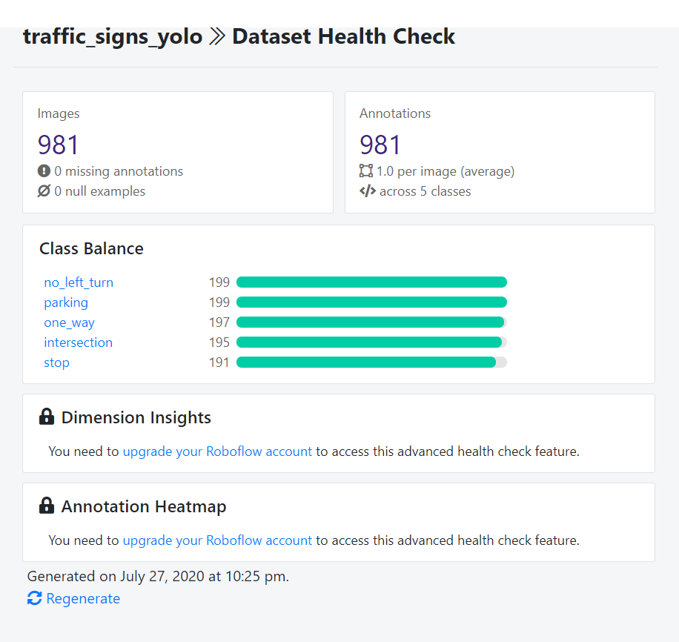
Double our datasets

Slide 3
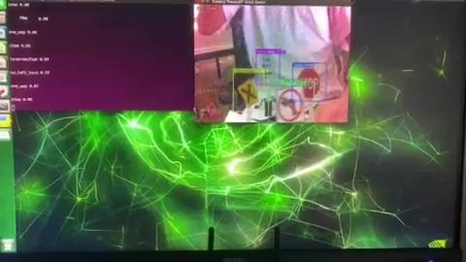
Trained Yolov4 and Test on Jetbot

Slide 4
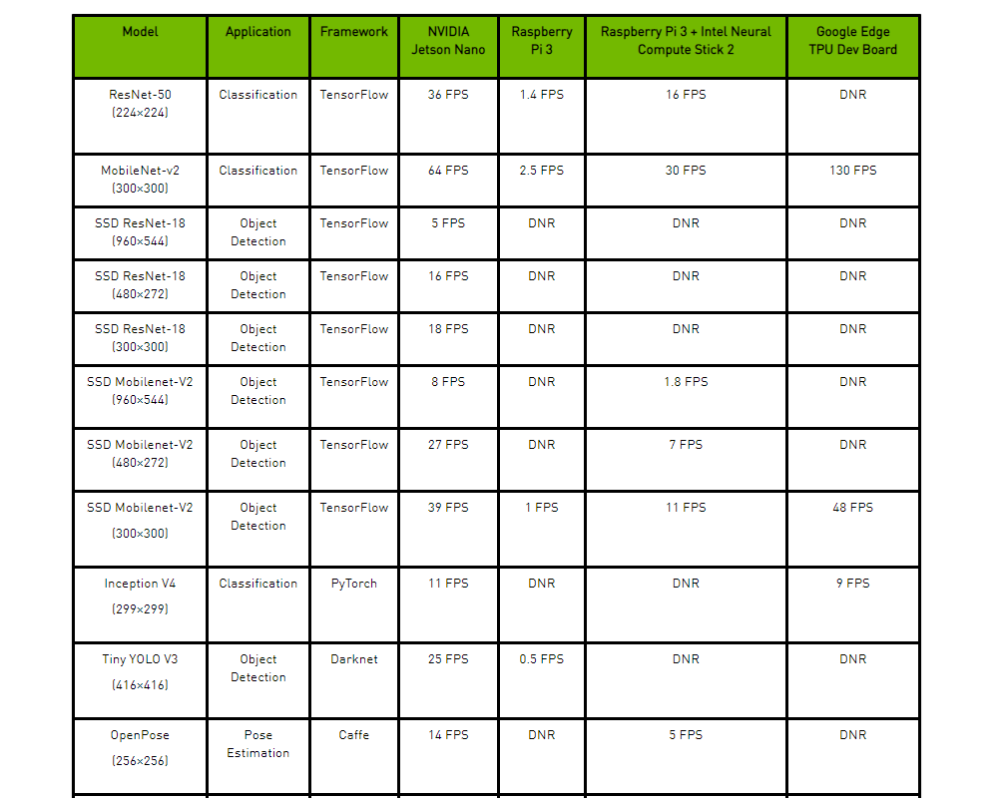
Next try Yolov4 Tiny and train SSDmobile_net on Computer

